Slide 1
UI & UX -
UX Design Principles
Welcome
ITUX5.210 User Experience & User Interface Design

Slide 2

This session
This session we will be covering:
The importance of Design
User centered design
Learning Outcomes:
Overview of UCD processes and techniques
The role of the UX Designer
Notes:
Photos courtesy of https://kaboompics.com/photo/725/water-sports

Slide 3
Design Thinking
What is Design Thinking
The process of applying skills and knowledge to solve problems in an innovative manner.
Objectives of design thinking are:
Minimize cost of development
Minimize development time (IE Time to market)
Provide optimum quality (both in terms of product as well as long term support)
Develop solutions that provide a truly positive user experience
Notes:
Photos courtesy of https://www.freepngimg.com/

Slide 4
Design Thinking
Steps in Design Thinking
The following overall steps are followed in design:
fully understand the problem, needs and expectations.
explore a broad range of possible solutions.
Iterate through mockups and prototypes before committing to code or higher fidelity design. Iteration involves both user and expert evaluation.
Implement the final product and deploy accordingly.
Post-deployment iterations incorporate user feedback.
Notes:
Photos courtesy of https://www.freepngimg.com/

Slide 5
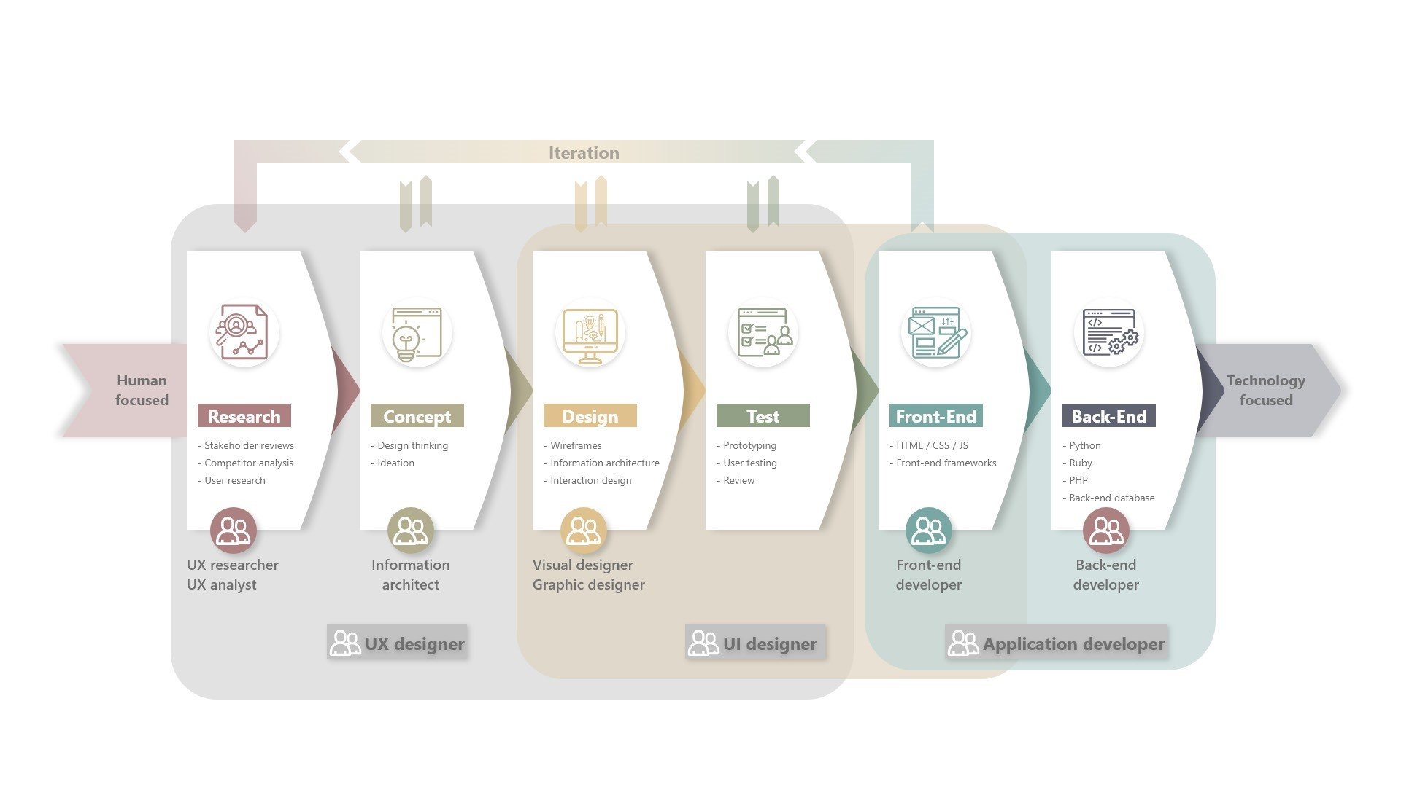
Importance of Design
Notes:
Photos courtesy of https://www.freepngimg.com/

Slide 6
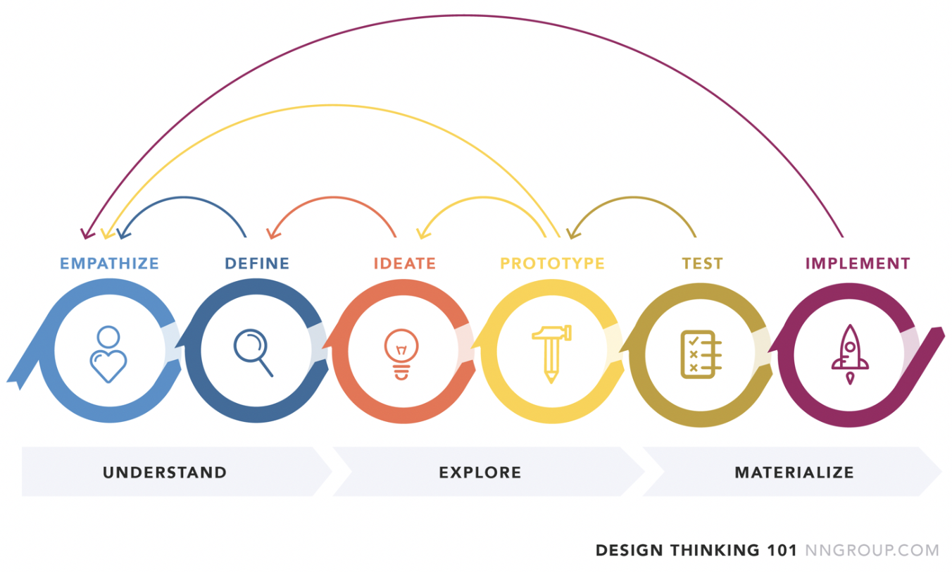
Notes:
Phase[MB1] 1: Empathise
The first phase involves empathising with the users who require a solution to a problem. The purpose is to understand the problem and needs clearly, without making any assumptions. This phase requires observations and discussions with the users to determine and understand how they work, live and interact with existing products. The goal is to discover as much as possible about them which will help to define and clarify the problem.
Phase 2: Define
Once you have a better understanding of your target audience, your next step is to define the problem. The purpose is to clearly identify the problem you wish to solve.
Phase 3: Ideate
Once we have defined the problem you can begin generating ideas to solve the problem. This is referred to as ideation. The focus will be to generate as many different solutions and evaluate them to determine the best designs which will then be prototyped.
Phase 4: Prototype
Once you have several likely solutions, you can then begin the prototype(s). The prototype can take many different forms; it can be a simple sketch, a wireframe or even a physical design.
Phase 5: Test
Once we have built the prototype(s), testing begins with the real user to gain feedback on the suitability of the design. This will provide insight on how it could be improved.
Phase 6: Implement
There may be many cycles of prototyping and retesting before you finally determine you have found the best solution. Once you have this, you can implement the final design.
The whole process may require a number of iterations throughout (or between one or two steps) to ensure that the most creative and innovative solution is developed.

Slide 7
Importance of Design
Key players in a project:
Users (Examples)
Social Media members
Web browsing & applications
Application users
Stakeholders
Shareholders
Business owners
Management
Developers
Shareholders
Business owners
Management
Notes:
Photos courtesy of https://www.freepngimg.com/

Slide 8
Importance of Design
Stakeholder Expectations and priorities:
Streamlining budgets and minimizing costs
“Should cost nothing to develop and deploy”
Maximizing product uptake by market
“Should exceed all expectations”
Shortest possible time to market
“I want it now!”
Notes:
Photos courtesy of https://www.freepngimg.com/

Slide 9
Importance of Design
Developers Expectations and priorities:
Utilization of appropriate skills and technologies
“Users prefer to use X. If only we could convince them to use Y.”
Often place majority of focus on (application or web) backend
“Users know what to do, so only a basic user interface is required”
Feature creep (providing more than what is required)
“I write great code. I’ll demonstrate by adding this new function!”
Notes:
Photos courtesy of https://www.freepngimg.com/

Slide 10
Importance of Design
User Expectations and priorities:
Low cost or even free
“I’m a student, what do you mean I have to pay?”
Ease of Use
“This interface is confusing, I’m outta here!”
Secure
“I use this app as I’m confident my private data is safe”
Feature packed
“This program does everything I expect of it”
An overall positive User Experience
“Wow, this application is very pleasing to use, and fast!”
Notes:
Photos courtesy of https://www.freepngimg.com/

Slide 11
Importance of Design
Stakeholders
You
Developers
Users
Notes:
Photos courtesy of https://www.freepngimg.com/

Slide 12
Importance of Design
Product development contention
Low Cost
Low cost
excellent quality
But long time to market
Low cost
fast development
But low quality
Mutual
Agreement
Quality
High cost
Time to market
Notes:
Photos courtesy of https://www.freepngimg.com/

Slide 13
Aesthetics in Design
Balancing form and function
It’s important to establish a good balance between aesthetics (form) and function.
Usability forms part of the overall user experience. A good user experience is not possible unless an interface provides for the users expectations in functionality.
The beauty of an interface forms part of the overall user experience. Good overall user experience requires beautiful aesthetics
Beauty is in the eye of the beholder. An industrial machine operator has different expectations of his Human Machine Interface (HMI) compared to the user of a GPS navigation aid in a high end luxury car.
Function should always take slight precedence over form. It’s more important an application does what it needs to do, as opposed to looking good.
Notes:
Photos courtesy of https://www.freepngimg.com/

Slide 14
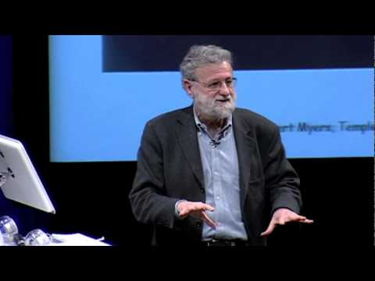
Aesthetics in Design
Emotion & Design: 3 Ways Good Design Makes you Happy with Don Norman
It's not you. Bad doors are everywhere.

Slide 15

User Centered Design
A well designed user interface has three primary outcomes:
Easy for the user to become familiar with and competent in using during first contact with the product
Easy for the user to achieve their objective when using the device
Easy for the user to recall and navigate through the interface in future
Notes:
Photos courtesy of https://www.freepngimg.com/

Slide 16
User Centered Design
Best practice:
Follow User Centered Design (UCD) policies and methodologies throughout the user interface design process.
Be aware of the needs of your users
When designing your interface, ask questions from the perspective of the user
Notes:
Photos courtesy of https://www.freepngimg.com/

Slide 17
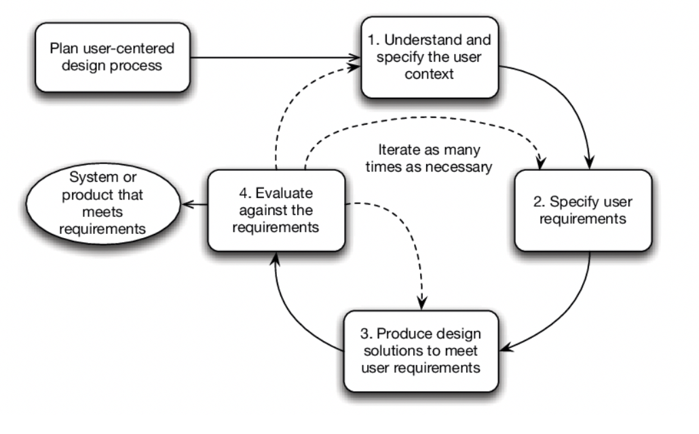
User Centered Design Process

Slide 18
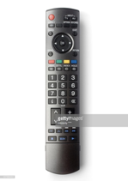
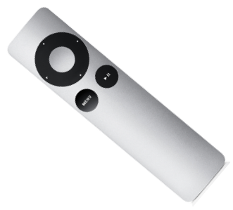
Comparing designs - which is better and why?
Aesthetics in Design
Notes:
Which one you choose depends on your own perception and past experiences – so there is no wrong answer. However, both have advantages and disadvantages:
· The first remote has a lot of buttons but they are generally clearly labelled. However, how many of these buttons would you use day to day?
The Apple TV remote is significantly less cluttered with only three buttons (which are context sensitive). Though the Apple remote looks less complicated, a user needs to know which button to press, and for new users this may not be clear.

Slide 19
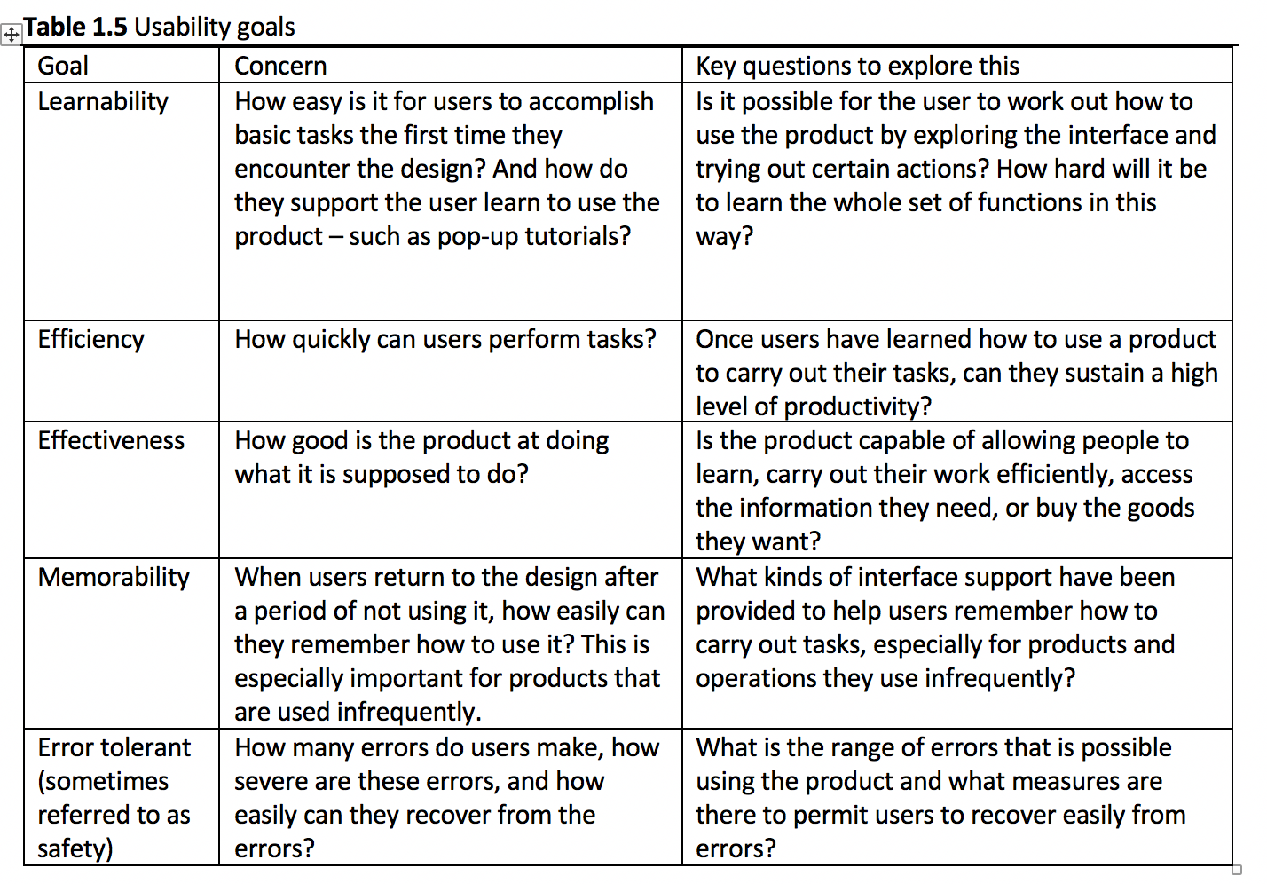
Usability
Goals

Slide 20

Usability Goals
Group exercise
Review the following websites and discuss the usability goals mentioned in the previous slides
Write down what concerns and key questions you think may have arisen during the design phase of these websites.
In your opinion, were they appropriately addressed?
https://www.mitre10.co.nz/
https://www.2degrees.nz/
https://www.pennyjuice.com/

Slide 21
User Interface Design
Balsamiq
A short-term license has been issued for all students to use Balsamiq. Balsamiq is an excellent low fidelity prototyping tool that can be used for your wireframe designs
Refer to document in EIT Online -> ITUX5.210 Course -> Student resources (How to install Balsamiq). The license key is included therein.
Balsamiq aside, you are free to use any wireframe design tool that you may prefer. There are several available including Adobe, JustinMind etc. Refer to lecturer for prior approval
Notes:
Photos courtesy of https://www.freepngimg.com/

Slide 22
Homework
Read and familiarize yourself with the methodologies found here, that are commonly used to evaluate and develop usability and overall user experience. We will be learning in more detail about (and implementing) a few of these methods as part of the course. Do not fret over too much detail. The objective here is that you have at least a rudimentary idea of what is entailed for these methods, and the benefits provided.
https://uxmastery.com/resources/techniques/
Notes:
http://www.clipartpanda.com/clipart_images/school-principal-66860936
http://www.clipartpanda.com/clipart_images/free-pot-of-gold-clipart-32059459
https://www.freepngimg.com
Guidelines and Principles can be found in Designing the User Interface (book by Ben Shneiderman and Catherine Plaisant)

